Slide 1
Remote-Controlled Pesticide Spraying and Field Assistance Car for Farmers Using Arduino
Course Code: | EEE 4103 | Course Name: | Microprocessor and Embedded Systems
SL # | Students ID | Students Name | Program | Section
1 | 22-48990-3 | Shahriar Hossain | BSc in CSE | R
2 | 22-49002-3 | Al Mubtasim | BSc in CSE | R
3 | 22-49012-3 | Adiba Tanzila | BSc in CSE | R
4 | 22-49029-3 | MD.Rakib Hasan | BSc in CSE | R
5 | 22-49959-3 | Md.Imdadul Hasan(Ayon) | BSc in CSE | R
Course Teacher: Prof. Dr. Engr. Muhibul Haque Bhuyan
Professor
Department of Electrical and Electronic Engineering

Slide 2

Outline of the Presentation
Aims and Objectives (1 slide, numbered lines) << What are the purposes of this work?
Introduction (2-3 slides) << Background, motivation, etc. What has been done?
Literature Review (2-3 slides) << What others have done? What are their outcomes and research gaps?
Research/Working Method (1-2 slides) << What are your research methods/working principles?
Description of the Work (2-3 slides) << How has the work done? Include circuit/block diagram, equations /mathematical model, etc. Show sample calculations, if any.
Survey Report (2-3 slides) << How many questions and what are the survey outcomes?
Gantt Chart (1 slide, tasks vs. time frame) << How did you plan to finish the proposed project?
Results, Outcomes, and Discussions (in the form of Tables/Graphs/Plots/Images/Photos/ Figures in 2-6 slides) << What is your present outcome? Discuss each result/outcome.
Conclusions (1 slide) << What is your summary?
Future Works (1 slide) << Wat can be done next? How may one proceed further on it?

Slide 3
Aims and Objectives of the Work
To develop and incorporate Bluetooth or communication between a mobile device and the microcontroller to receive directional and spray commands remotely.
To simulate and test motor control and spraying functions using Arduino IDE and Proteus to ensure accurate system responses before deploying the physical model.
To implement control of dual motors via the L298N driver module for directional navigation and activate the pesticide pump through a relay-controlled sprayer.

Slide 4
Aims and Objectives of the Work
To design and implement a remote-controlled pesticide spraying vehicle using Arduino ESP32 microcontroller integrated with an L298N motor driver to automate safe pesticide application.
To analyze and validate movement control and spraying mechanism performance in a test environment to ensure consistent operation and user safety.

Slide 5
Introduction
Traditional pesticide spraying exposes farmers to harmful chemicals
Manual methods are labor-intensive and inefficient for large fields
IoT-based solutions like ESP32 offer smart, safe, and precise control

Slide 6
Introduction
Ensure user safety by reducing direct contact with pesticides
Promote automation in agriculture using low-cost microcontrollers
Develop a scalable prototype for smart farming applications

Slide 7
Literature Review
A. N. Babu et al. (2023) Introduced an IoT-based pesticide spraying robot that allows real-time user control. However, it lacks sensors to detect terrain or obstacles, making it less effective in uneven or complex fields.
S. T. Ayyagari et al. (2021) Developed a solar-powered robot that can both spray pesticides and mow weeds. The combination of multiple features makes the system too complex and expensive for small farms.
M. A. Naik et al. (2025) Presented a telerobotic sprayer for greenhouses using ultrasonic sensors to target plants. While efficient in reducing pesticide use, the design is complicated and costly due to its reliance on real-time video and multiple sensors.

Slide 8
Literature Review
J. F. Kayode et al. (2023) Designed a solar-powered pesticide sprayer using Bluetooth control. The system depends heavily on sunlight and has a short operation time per tank, which limits its practicality in large fields or cloudy weather.
P. K. C. et al. (2024) Proposed a remote-controlled sprayer with a self-propelled mechanism. While the concept is promising, the paper lacks details on the control system and power source, making it hard to assess reliability or range.

Slide 9
How Our Work Is Different
Simpler for Real-World Use While some projects like Ayyagari et al. included mowing and spraying together, our system focuses only on spraying to keep it easy to build, maintain, and actually use on small farms.
Affordable and Weather-Independent Unlike solar-based systems such as those by Kayode et al., our ESP32-powered design does not rely on sunlight. It is low-cost and works consistently, making it more practical in varying field conditions.
Balanced Approach to Safety and Usability Some research, like Naik et al., added complex sensors and video systems. We offer safety through remote control but keep the setup suitable for farmers who need efficiency without the tech burden.

Slide 10
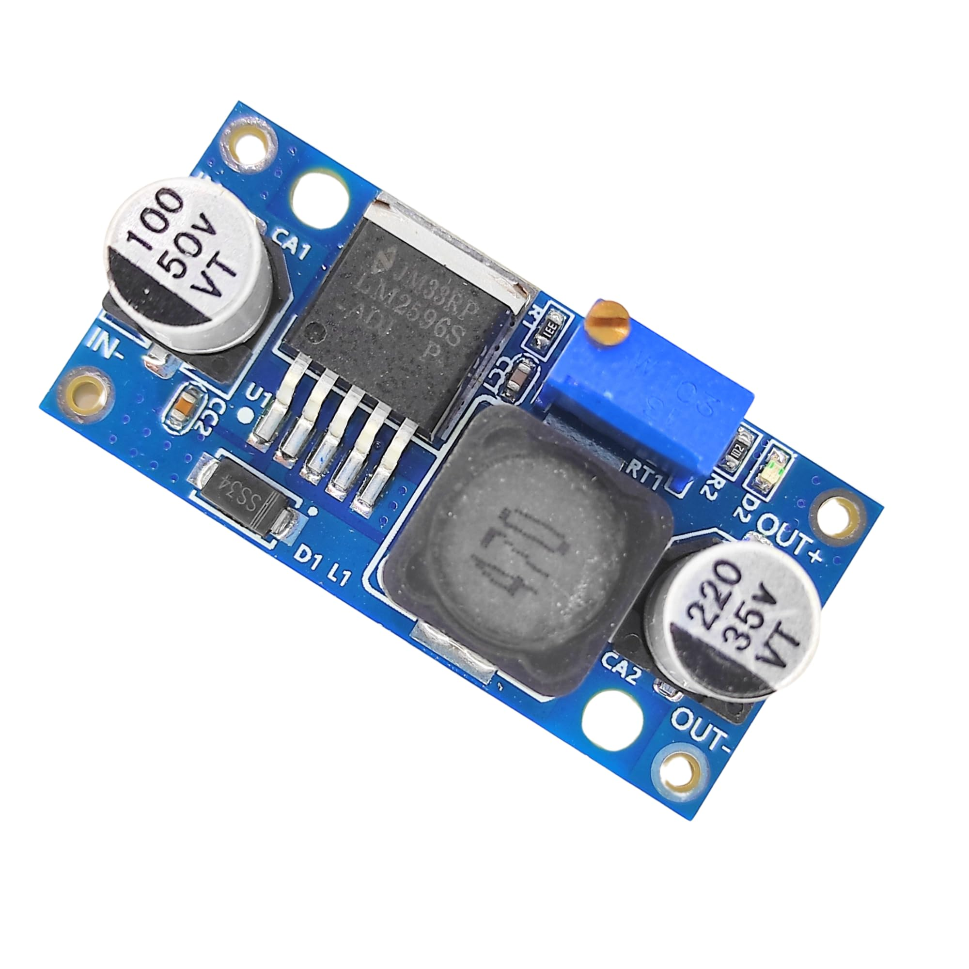
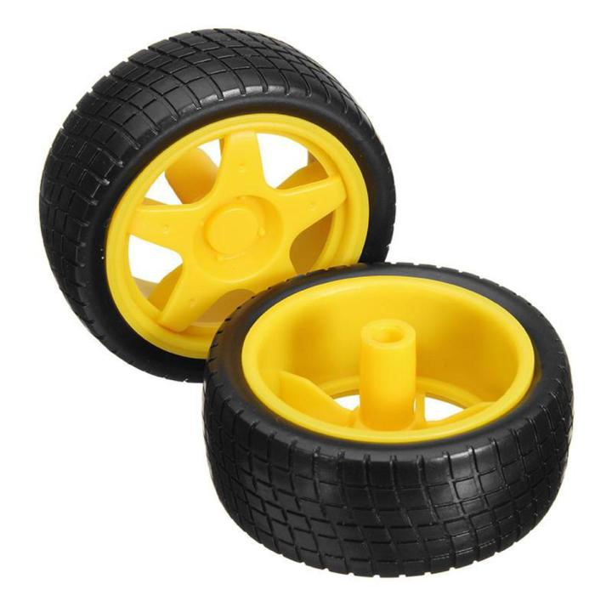
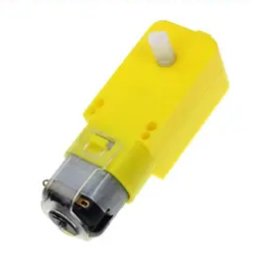
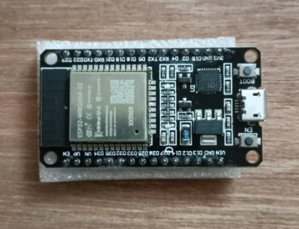
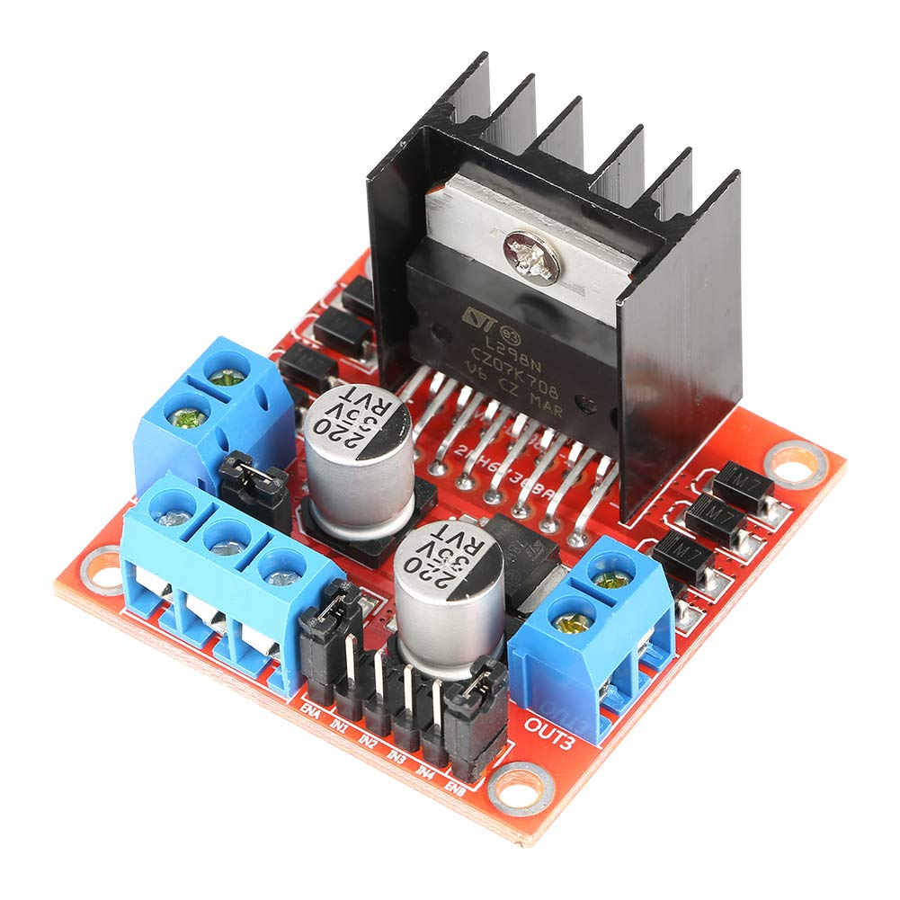
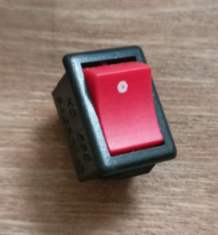
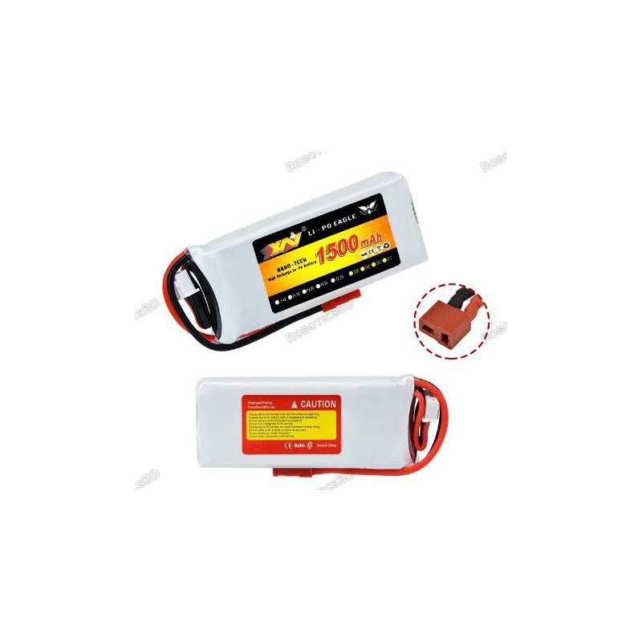
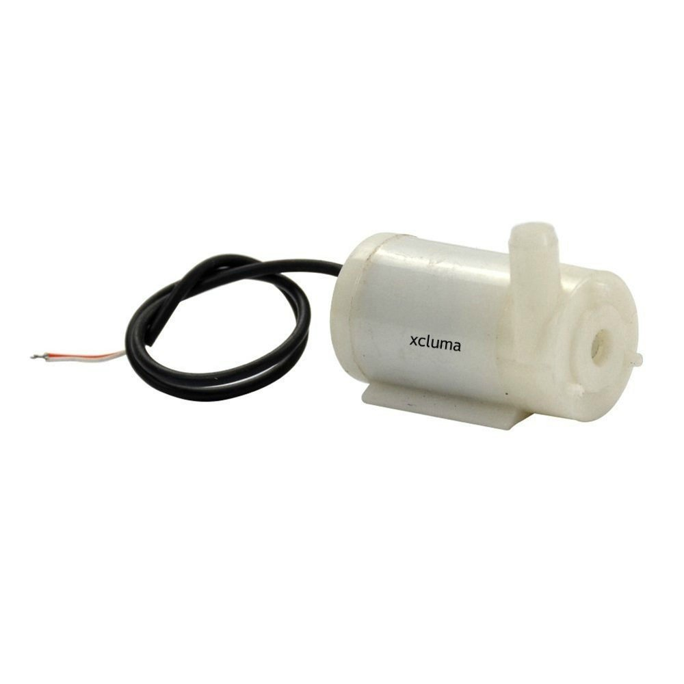
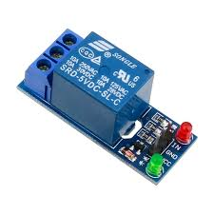
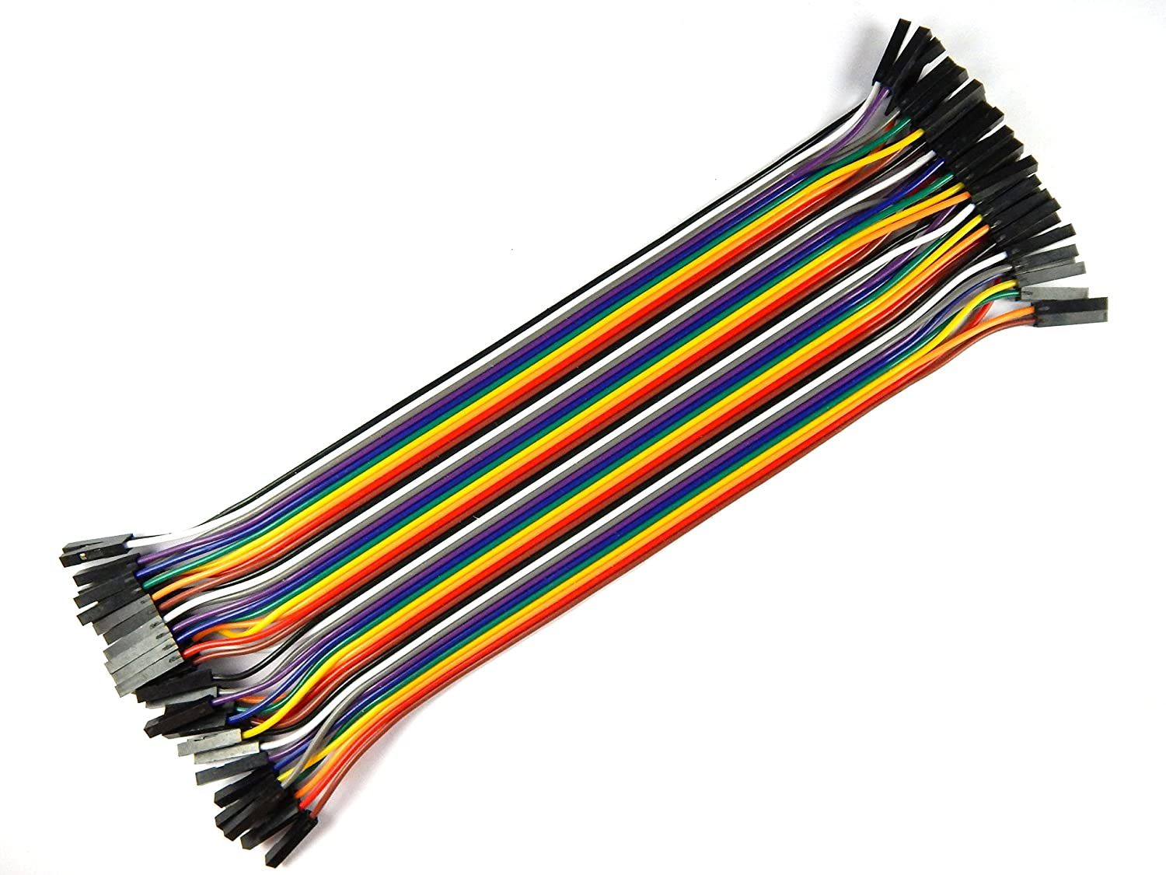
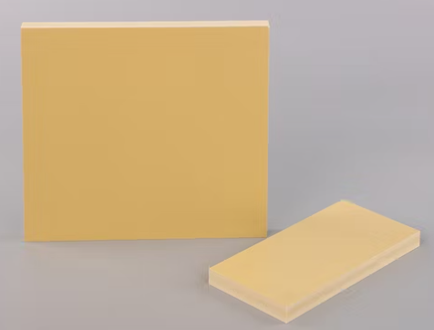
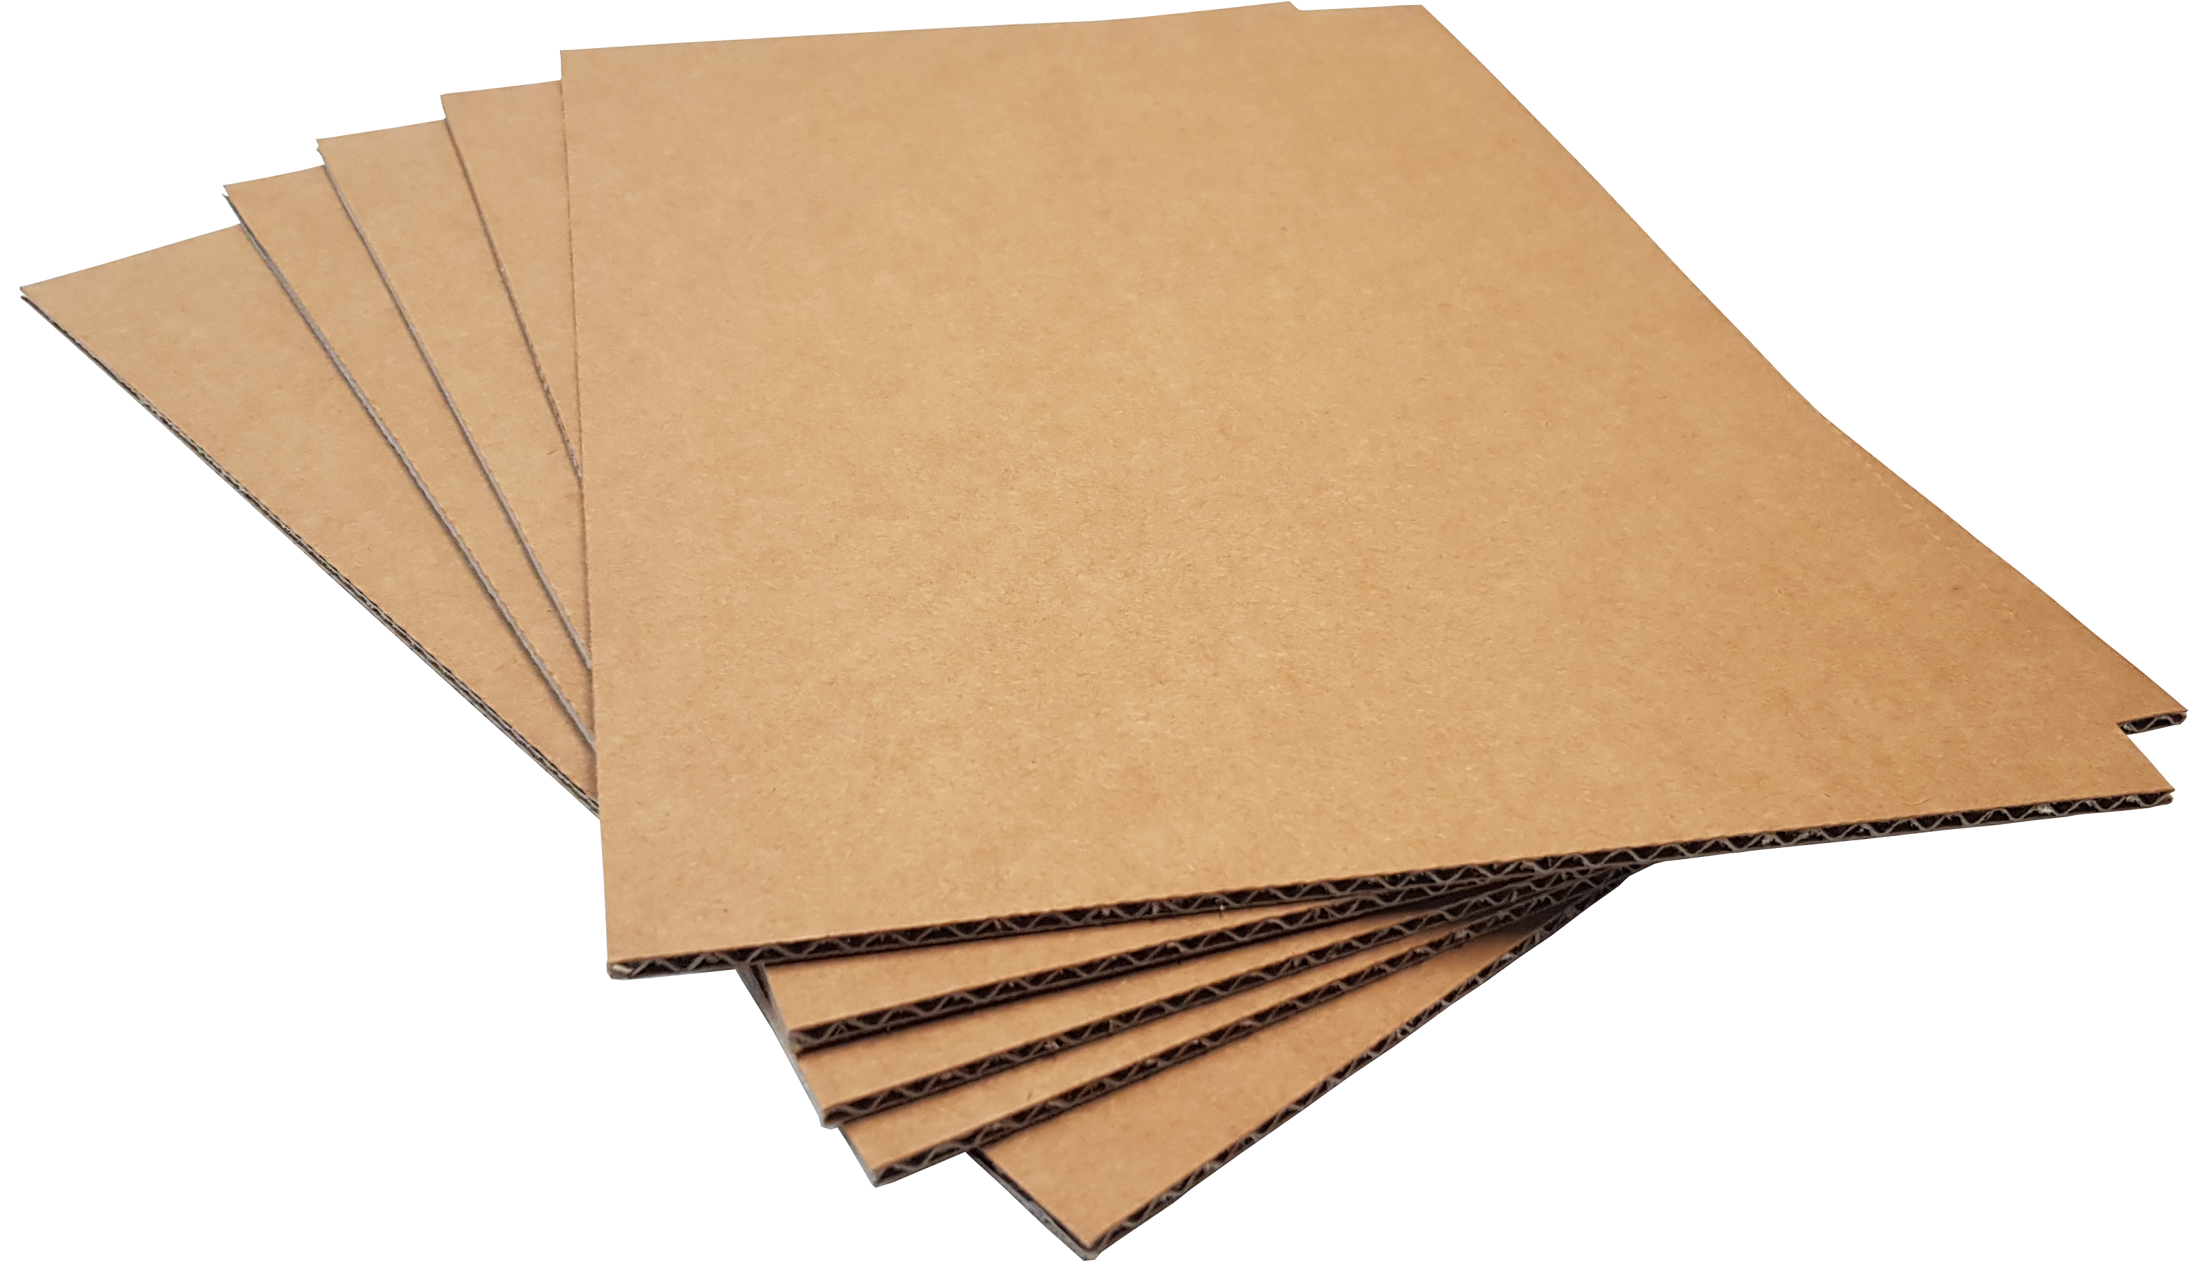
Apparatus
Wheels
Wheel Motor
ESP32
LM2596(Buck Converter)
L298N
Switch
1500MaH 7.4V LiPo Battery
3V DC Waterpump
Relay Module
Cardboard
Jumper Wire
WPC Board

Slide 11
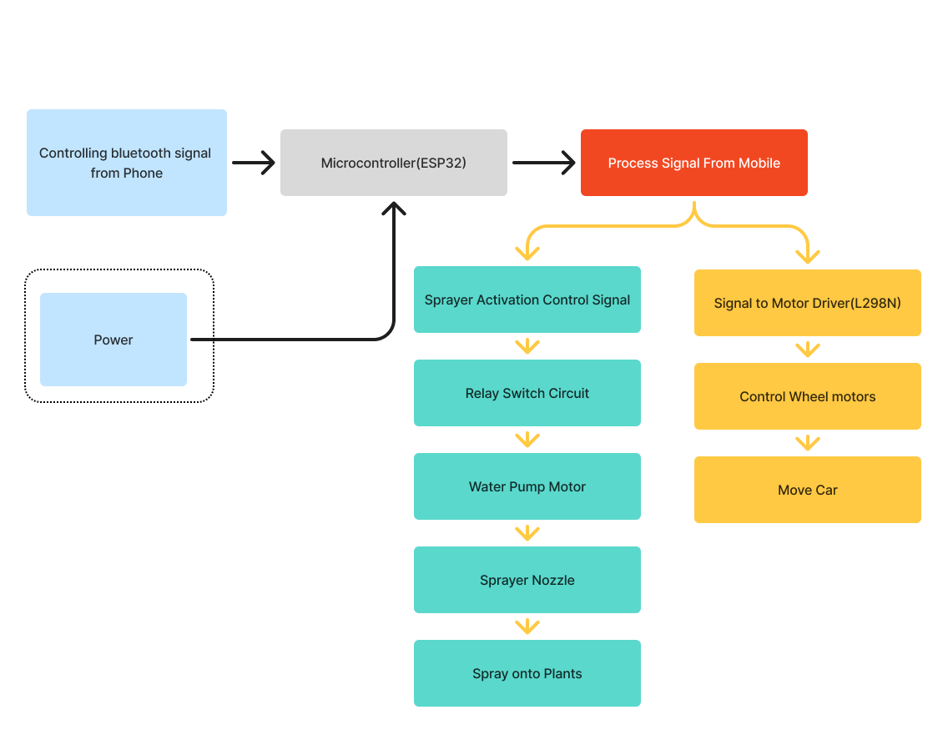
Working Method
A power source(Battery) supplies energy to the microcontroller and all connected components, ensuring smooth system operation during the demo...
Block diagram of the system

Slide 12
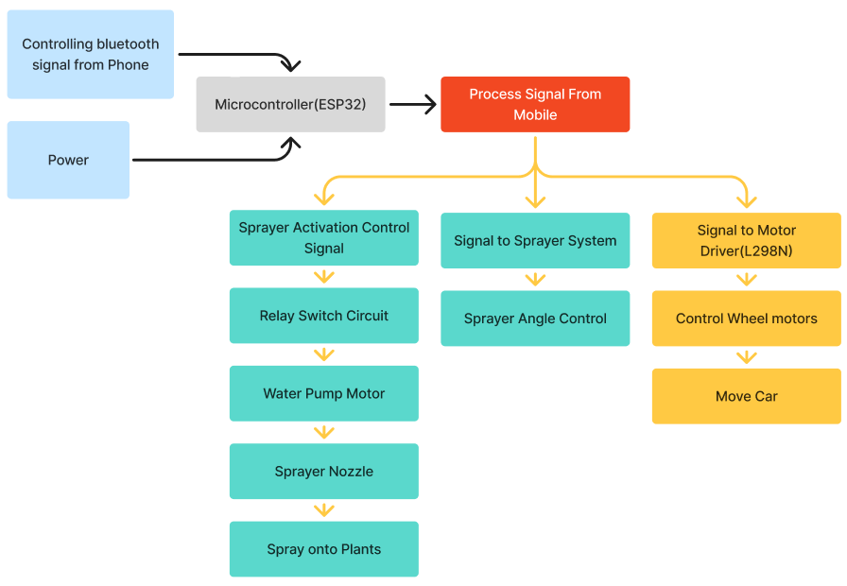
Working Method
A mobile phone sends control signals to the ESP32 microcontroller using Bluetooth.
The ESP32 processes the received signals and decides whether to activate the sprayer, adjust its angle, or move the vehicle…
Block diagram of the system

Slide 13
Working Method
When spraying is triggered, the ESP32 sends a signal to a relay switch circuit.
This activates the water pump motor, which pushes pesticide through the sprayer to spray onto plants...
Block diagram of the system

Slide 14
Working Method
For navigation, the ESP32 sends movement commands to an L298N motor driver.
The motor driver controls the wheel motors to move the car forward, backward, or turn as needed.
Block diagram of the system

Slide 15
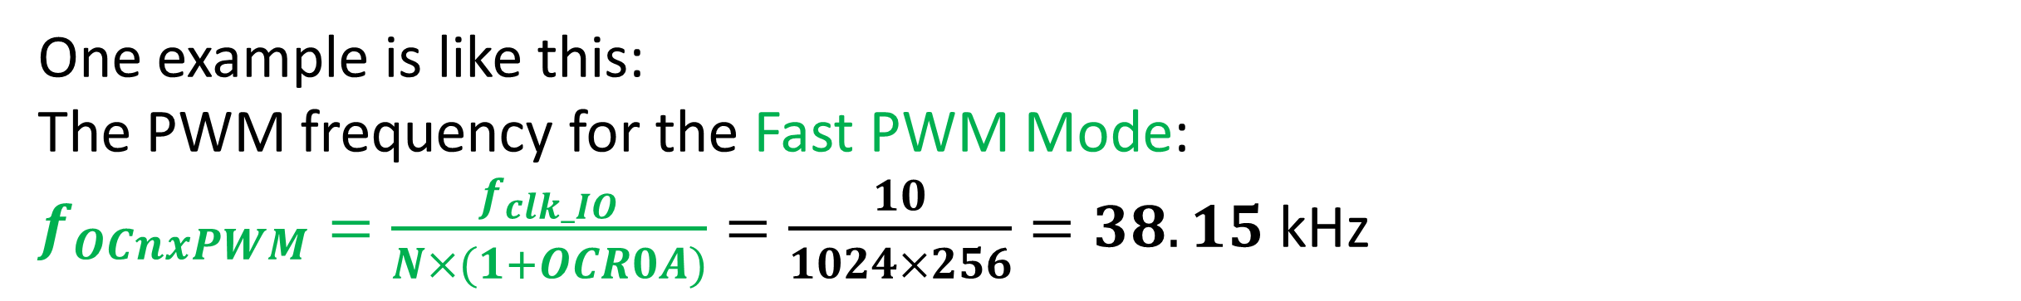
Equations/Mathematical Model
Must use equation editor to present equations. Values must be inserted to show the sample calculations.
One example is like this:
The PWM frequency for the Fast PWM Mode:
$f_{OCnxPWM}=\frac{f_{clk_IO}}{N×(1+OCR0A)}=\frac{10}{1024×256}=38.15$ kHz

Slide 16
Survey Report
Link: https://forms.gle/3RFasstXoVQzWAbF6

Slide 17
Survey Report
Link: https://forms.gle/3RFasstXoVQzWAbF6

Slide 18
Survey Report
Link: https://forms.gle/3RFasstXoVQzWAbF6

Slide 19
Survey Report
Link: https://forms.gle/3RFasstXoVQzWAbF6

Slide 20
Survey Report
Link: https://forms.gle/3RFasstXoVQzWAbF6

Slide 21
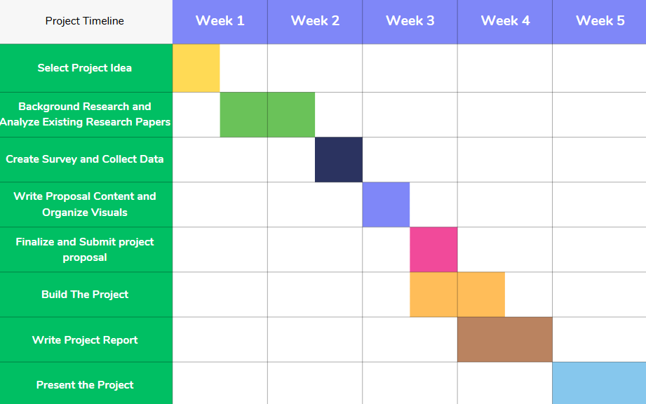
Gantt Chart

Slide 22
Outcomes/Results and Discussions
Present and describe your current data or results in 2-6 slides with graphs/figures/tables/images, etc.
Discuss results side-by-side or in another slide
If there are multiple plots in one figure, then legends must be given for each plot.
Gaussian in (Zhou et. al., 1999)
Hyperbolic cosine in (Zhou et. al., 2000)
Table Caption should be here at the top of the table
R1 | 1 | 0 | 1 | 0 | C=0 | R2=0
R1 | 0 | 1 | 0 | 1 | C=0 | R2=0
R1 | 0 | 0 | 1 | 0 | C=1 | R2=1
R1 | 0 | 0 | 0 | 1 | C=0 | R2=1
R1 | 0 | 0 | 0 | 0 | C=1 | R2=2
Figure Caption should be here at the bottom of the figure

Slide 23
Conclusions
Conclude with in 1 slide
SL # | Test Condition | Observation
1 | Control Car | Moves in input direction
2 | Spray Button | Sprays for 2 seconds, then turns off
3 | Speed | Low

Slide 24
Future Scopes
List your future works that you want to present during your final presentation in 1 slide.

Slide 25
Thanks for listening our presentation….
?

